Slide 1


Predicting and Analyzing Key Factors Influencing Underweight Women: A Machine Learning Approach with Feature Importance Analysis.
Christian Campbell

Slide 2
Business Problem
Significant health and socio-economic impacts
Focus on women aged 15-49 with BMI < 18.5
Targets contributing factors for better public health strategies

Slide 3
Background/History
Malnutrition prevalent among women in Sub-Saharan Africa
Comparable to other developing regions, but less severe than South Asia
Influences maternal mortality and low birth weight

Slide 4

Data
Data from 11 countries prioritized by USAID Feed the Future
Features: urban/rural location, altitude, rainfall, climate, socio-economic indicators
Data preparation: handling missing values, numerical encoding of categories

Slide 5
Methods
Random Forest Regressor with GridSearchCV for optimization
Feature importance analysis and SHAP values
Evaluation metrics: MAE, MSE, RMSE, R-squared

Slide 6
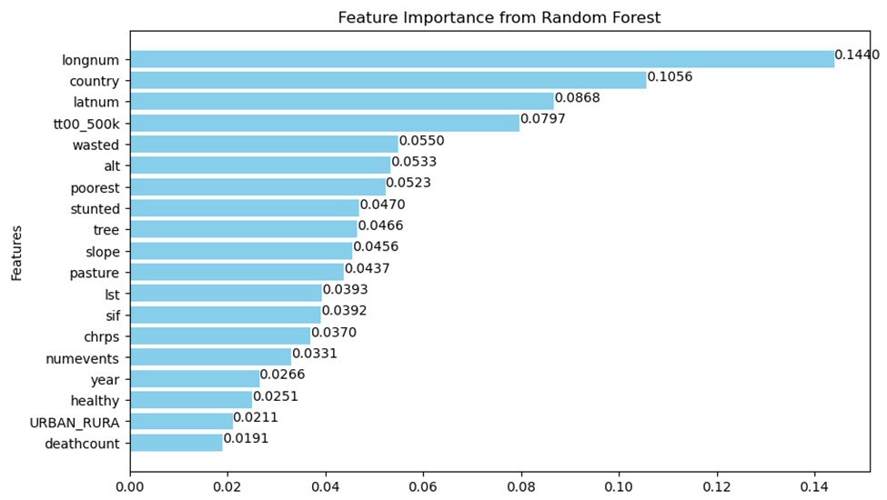
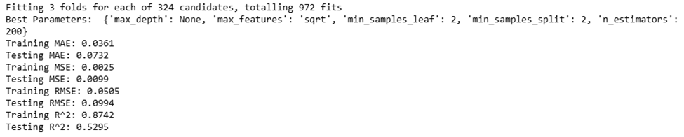
Analysis
Best model: 200 decision trees, optimal depth
Training performance: MAE = 0.0361, R² = 0.8742
Test performance: MAE = 0.0732, R² = 0.5295
Key influential features: longitude, country, latitude, travel time, wasting prevalence

Slide 7
Conclusion
Geography and economic factors as top influencers
Insights can guide public health strategies
Highlights the importance of targeted interventions

Slide 8

Assumptions
Data represents the studied population accurately
Imputation with column averages
Categorical data converted for model training

Slide 9

Limitations
Data quality and completeness
Region-specific applicability
Real-world factors not included

Slide 10

Challenges
Data preparation complexity
Model tuning with 972 parameter combinations
Translating findings into actionable insights

Slide 11
Future Uses/Additional Applications
Aid agencies for targeted resource allocation
Policy-driven interventions
Extendable to other health issues

Slide 12
Recommendations
Include
Include more variables like healthcare and education
Prioritize
Prioritize data quality
Collaborate
Collaborate with public health experts

Slide 13
References
Browne, C., Matteson, D. S., McBride, L., Hu, L., Liu, Y., Sun, Y., Wen, J., & Barrett, C. B. (2024, January 2). ML prediction of poverty and malnutrition dataset. Kaggle. https://www.kaggle.com/datasets/adamprzychodni/ml-prediction-of-poverty-and-malnutrition-dataset?select=Appendix.pdf
Browne, C., Matteson, D. S., McBride, L., Hu, L., Liu, Y., Sun, Y., Wen, J., & Barrett, C. B. (2021). Multivariate random forest prediction of poverty and malnutrition prevalence. PLOS ONE, 16(9). https://doi.org/10.1371/journal.pone.0255519
U.S. National Library of Medicine. (1996, January 1). Nutritional status. In Her Lifetime: Female Morbidity and Mortality in Sub-Saharan Africa. https://www.ncbi.nlm.nih.gov/books/NBK232554/

